Slide 1

Quick Write
How does the government make money?
Write for 1 minute
Compare what you have written with your partner for 1 minute.
Add to your ideas
Be prepared to share
Notes:
hook

Slide 2
Lesson objective
By the end of this lesson you will be able to;
Find the percentage of a number to calculate GST and Discounts.
Notes:
Lesson

Slide 3
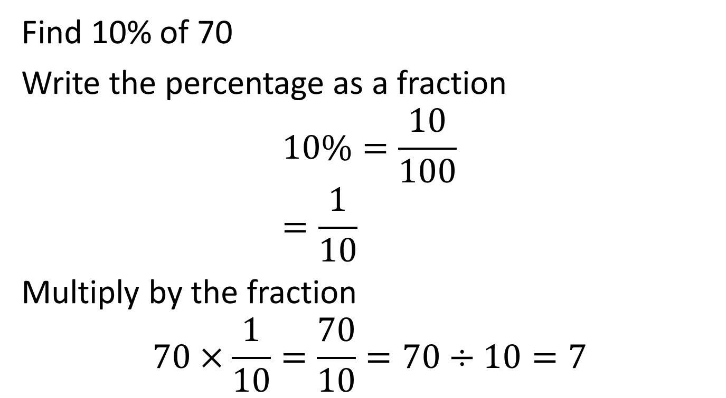
How to find a percentages?
Revision
Find 10% of 70
Write the percentage as a fraction
$$10\%=\frac{10}{100} \\ =\frac{1}{10}$$
Multiply by the fraction
$$70×\frac{1}{10}=\frac{70}{10}=70÷10=7$$
To find 10% we just divide by 10
SHORT CUT

Slide 4

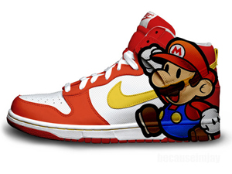
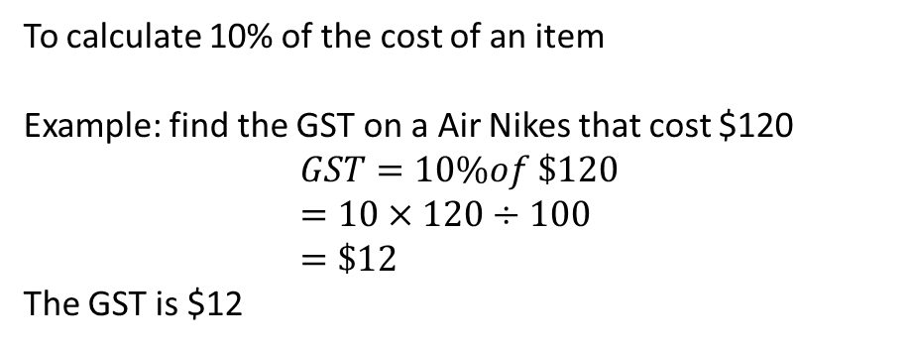
24
7
30
Date
GST and discounts
EQ – Describe the method of calculating GST and discounts
What is GST?
GST: Goods and Services Tax
GST is a 10% tax on all goods and services in Australia
How can find GST?
To calculate 10% of the cost of an item
Example: find the GST on a Air Nikes that cost $120
$$GST=10\%of \$120 \\ =10×120÷100 \\ =\$12$$
The GST is $12
5
Notes:
Lesson objective (EQ)

Slide 5
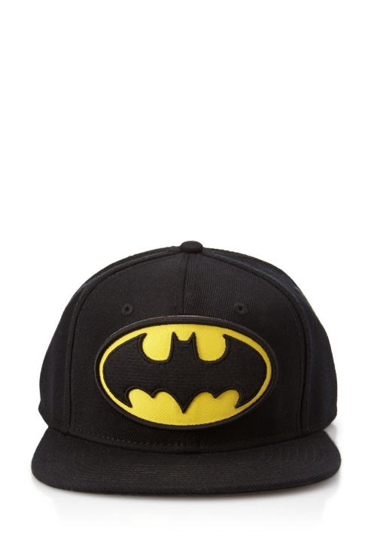
24
7
30
Date
GST and discounts
EQ – Describe the method of calculating GST and discounts
How can we find discounts?
Step 1: Find the percentage of the total amount
Step 2: Take the amount away from the total amount
A store has a sale of 20% off hats that cost $40
5
Notes:
Input

Slide 6


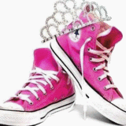
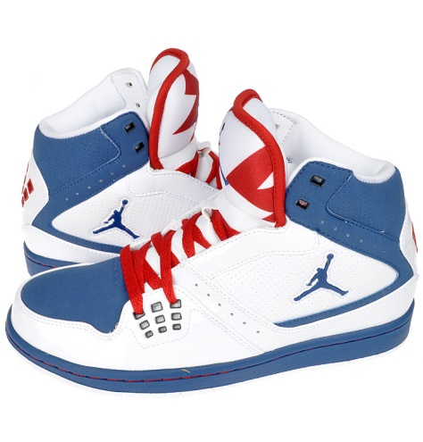
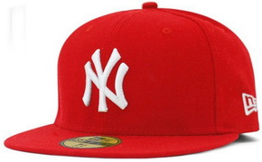
SALE SALE SALE
10% off shoes and 20% hats
Find the price of each of the following by applying the discount.
$30
$80
$50
$150
Notes:
Check for understanding/guided practice

Slide 7
SALE SALE SALE
10% off shoes and 20% hats
Find the price of each of the following by applying the discount.
$24
$72
$30
$80
$40
$50
$135
$150

Slide 8

Practice
Complete Exercise 4.2
on page 51
Notes:
Guided practice/ independent practice

Slide 9
What do you currently want to buy?
Task: Use your Ipad to research the price of the item you want to buy.
a) Calculate the GST on the item you want to buy
b) If the store has a sale of 20% off, what would you item cost now?
EXIT PASS
Notes:
Closure:
Students must complete this to leave

